Slide 1
Analyzing Sales Performance for Awesome Chocolates
Presented by Sumit Nerkar

Slide 2
The project aims to evaluate the sales data of "Awesome Chocolates" to uncover key insights into sales performance, customer behavior, product demand, and team efficiency. By leveraging SQL, the analysis focuses on enhancing decision-making for improved business outcomes.
Problem Statement
The dataset includes transactional data related to sales, products, customers, geographic regions, and team performance. The objective is to extract actionable insights by analyzing various aspects of the sales process, such as team contributions, product performance, sales trends, and geographic impact. This helps optimize business strategies, identify opportunities for growth, and address inefficiencies.

Slide 3
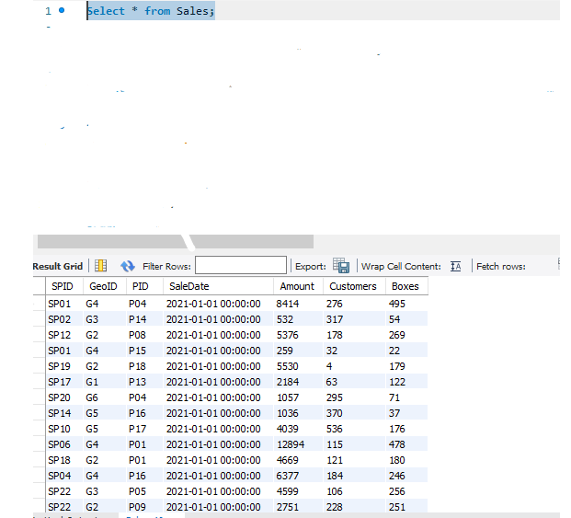
Write a query to retrieve all columns from the Sales table."

Slide 4
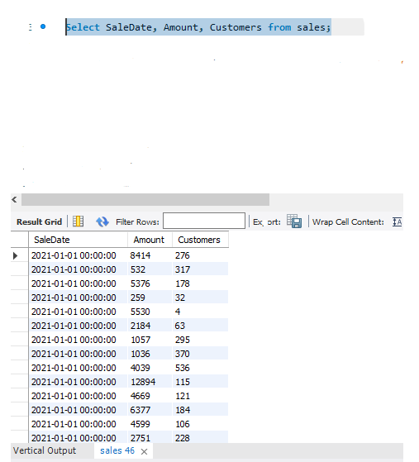
Write a query to retrieve the sale date (SaleDate), sale amount (Amount), and customers (Customers) from the Sales table.

Slide 5
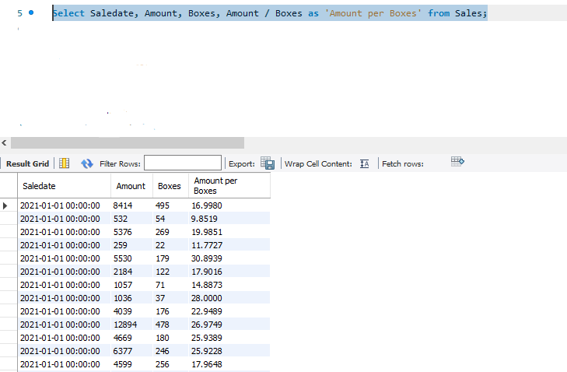
Write a query to retrieve the sale date (SaleDate), sale amount (Amount), number of boxes (Boxes), and calculate the amount per box (Amount / Boxes) from the Sales table."

Slide 6
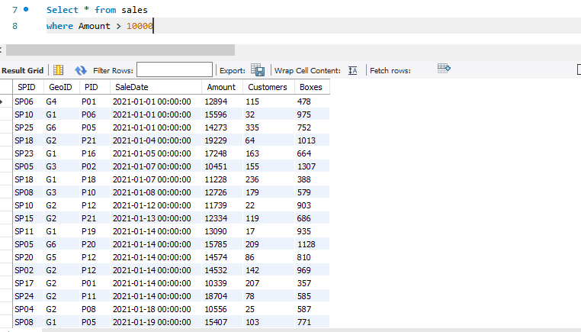
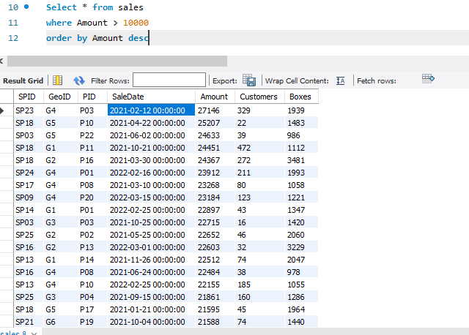
Write a query to retrieve all columns from the Sales table where the sale amount is greater than 10,000, and order the results by Amount first in ascending order and then in descending order."

Slide 7
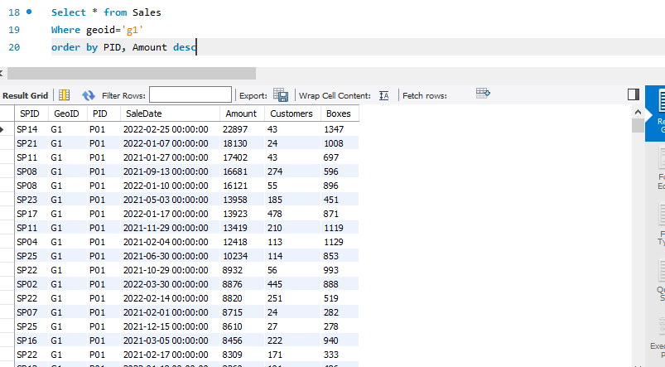
Write a query to retrieve all columns from the Sales table where the geoid is 'g1', and order the results by PID in ascending order and Amount in descending order."

Slide 8
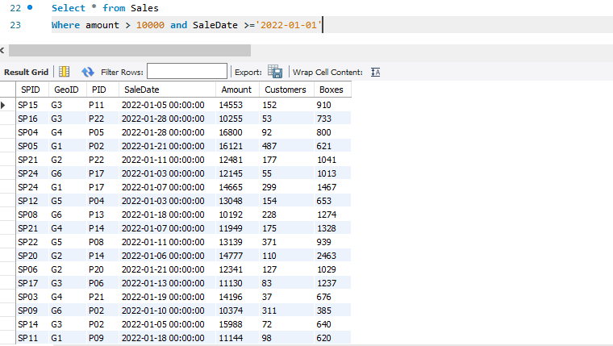
Write a query to retrieve all columns from the Sales table where the sale amount is greater than 10,000 and the sale date is on or after January 1st, 2022

Slide 9
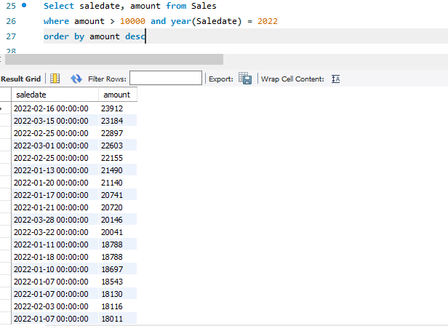
Write a query to retrieve the sale date (saledate) and sale amount (amount) from the Sales table, where the sale amount is greater than 10,000 and the sale occurred in the year 2022. Order the results in descending order of sale amount."

Slide 10
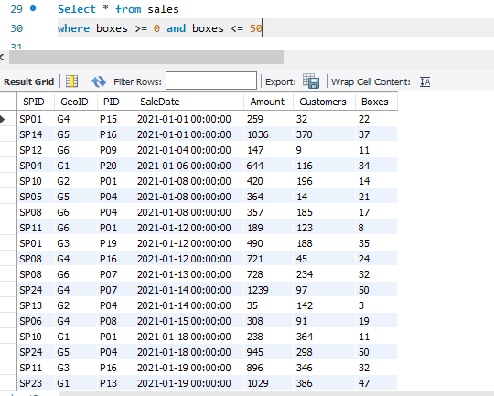
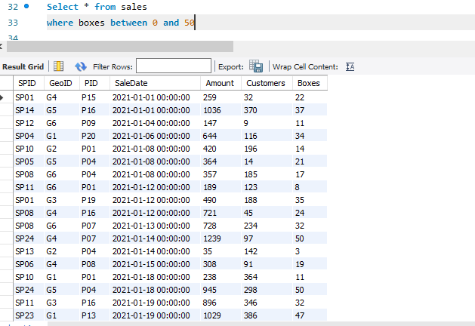
Write a query to retrieve all columns from the Sales table where the number of boxes (boxes) is between 0 and 50

Slide 11
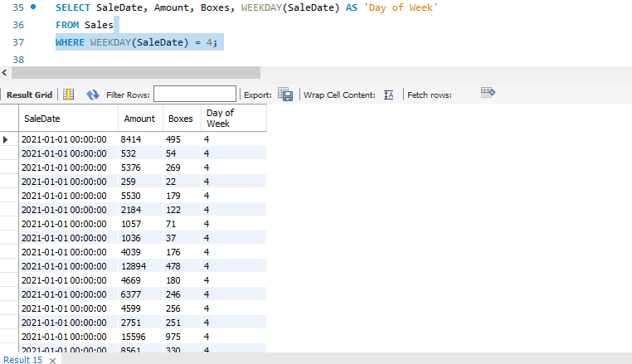
Write a query to retrieve the sale date (SaleDate), sale amount (Amount), number of boxes (Boxes), and the weekday of the sale (WEEKDAY(SaleDate)) from the Sales table, where the sale occurred on a Friday."

Slide 12
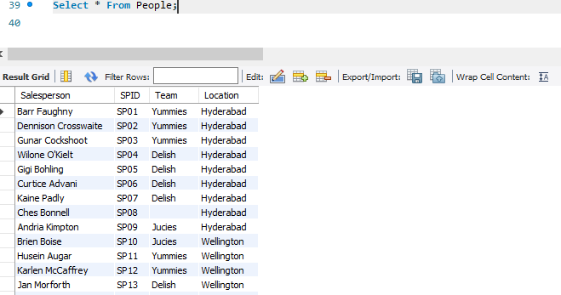
Write a query to retrieve all columns from the People table.

Slide 13
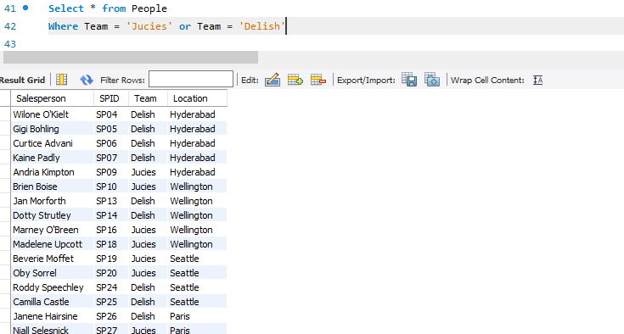
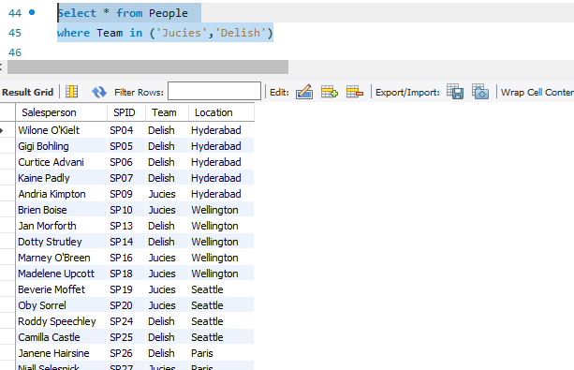
Write a query to retrieve all columns from the People table where the team is either 'Jucies' or 'Delish'.

Slide 14
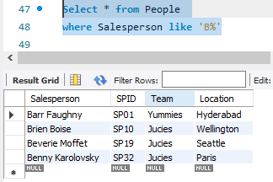
"Write a query to retrieve all columns from the People table where the salesperson's name starts with the letter 'B'

Slide 15
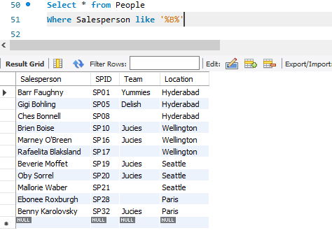
Write a query to retrieve all columns from the People table where the salesperson's name contains the letter 'B'."

Slide 16
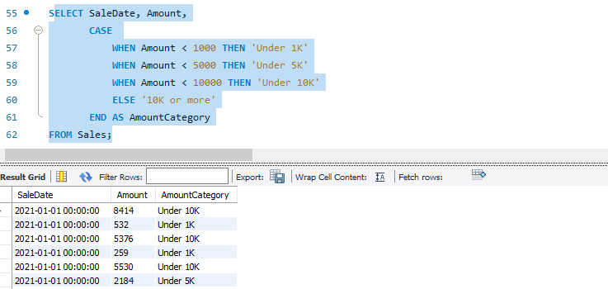
"Write a query to categorize sales amounts into different ranges ('Under 1K', 'Under 5K', 'Under 10K', and '10K or more') based on the Amount column from the Sales table. Additionally, include the SaleDate and the original Amount in the result, with the category labeled as AmountCategory."
This question specifies:
The purpose of categorizing sales data based on the Amount.
The inclusion of columns SaleDate and Amount.
Naming the new category column as AmountCategory.

Slide 17
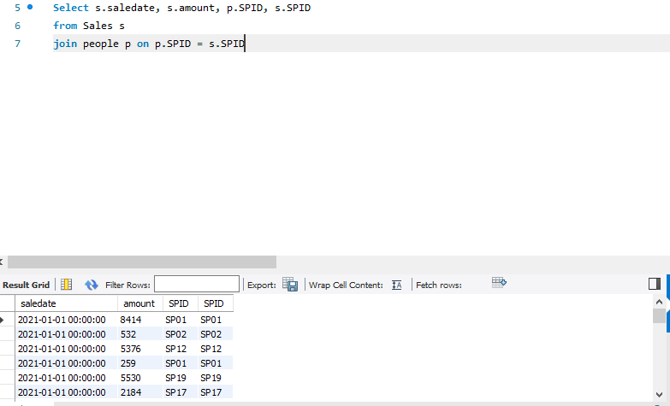
"Write a query to retrieve the sale date, amount, and salesperson information by joining the Sales table (s) with the People table (p) using the common column SPID. Include the columns s.saledate, s.amount, p.SPID, and s.SPID in the result."
This question specifies:
The need to join two tables (Sales and People) using a common key (SPID).
The requirement to retrieve specific columns from both tables.
Clear identification of aliases (s for Sales and p for People).

Slide 18
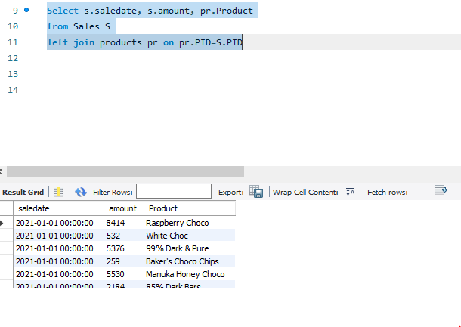
"Write a query to retrieve the sale date, amount, and product name by performing a left join between the Sales table (s) and the Products table (pr) using the common column PID. Include the columns s.saledate, s.amount, and pr.Product in the result."
This question specifies:
The use of a left join between the Sales and Products tables.
The columns to retrieve: s.saledate, s.amount, and pr.Product.
The common key for the join is PID.

Slide 19
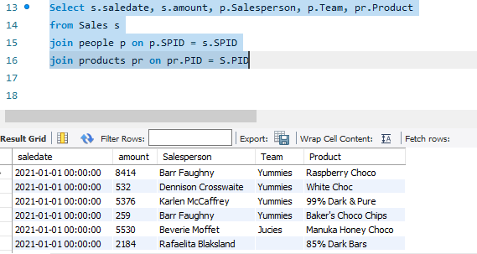
Write a query to retrieve the sale date, amount, salesperson name, team, and product name by joining the Sales table (s) with the People table (p) and the Products table (pr). Use the common columns SPID to join Sales and People, and PID to join Sales and Products. Include the columns s.saledate, s.amount, p.Salesperson, p.Team, and pr.Product in the result.
This question specifies:
The requirement to join three tables: Sales, People, and Products.
The common columns to join them are SPID (for Sales and People) and PID (for Sales and Products).
The columns to retrieve are the sale date, amount, salesperson, team, and product name.

Slide 20
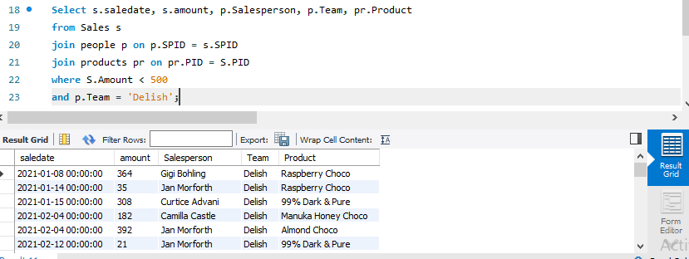
"Write a query to retrieve the sale date, amount, salesperson name, team, and product name by joining the Sales table (s) with the People table (p) and the Products table (pr). Use the common columns SPID to join Sales and People, and PID to join Sales and Products. Filter the results where the sales amount is less than 500 and the salesperson's team is 'Delish'. Include the columns s.saledate, s.amount, p.Salesperson, p.Team, and pr.Product in the result."

Slide 21
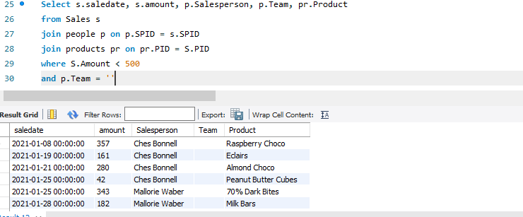
"Write a query to retrieve the sale date, amount, salesperson name, team, and product name by joining the Sales table (s) with the People table (p) and the Products table (pr). Use the common columns SPID to join Sales and People, and PID to join Sales and Products. Filter the results where the sales amount is less than 500 and the salesperson's team is empty (i.e., p.Team is NULL or ''). Include the columns s.saledate, s.amount, p.Salesperson, p.Team, and pr.Product in the result."

Slide 22
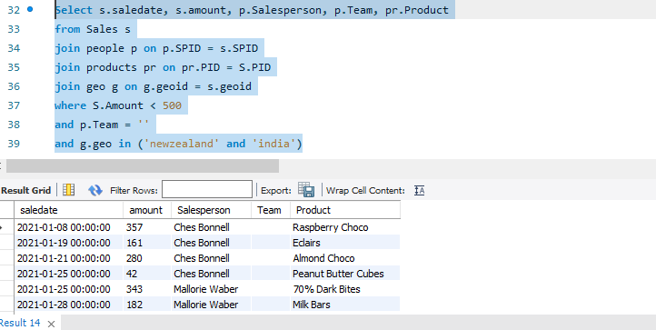
"Write a query to retrieve the sale date, amount, salesperson name, team, and product name by joining the Sales table (s) with the People table (p), the Products table (pr), and the Geo table (g). Use the common columns SPID to join Sales and People, PID to join Sales and Products, and geoid to join Sales and Geo. Filter the results where the sales amount is less than 500, the salesperson's team is empty (p.Team is ''), and the geographical region is either 'newzealand' or 'india'. Include the columns s.saledate, s.amount, p.Salesperson, p.Team, and pr.Product in the result."

Slide 23
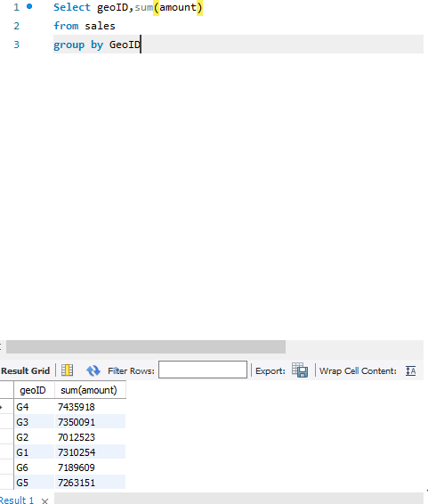
"Write a query to retrieve the total sales amount (sum(amount)) and the average sales amount (avg(amount)) for each geographical region, by grouping the data based on the GeoID column from the Sales table."
Explanation:
GeoID is used to group the data by each geographical region.
SUM(amount) calculates the total sales amount for each region.
AVG(amount) calculates the average sales amount for each region.

Slide 24
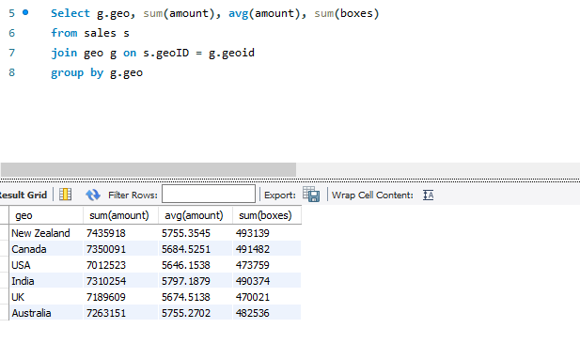
"Write a query to retrieve the total sales amount (sum(amount)), average sales amount (avg(amount)), and total boxes (sum(boxes)) for each geographical region, by joining the Sales table (s) with the Geo table (g) using the GeoID column. Group the data by the geo column from the Geo table."

Slide 25
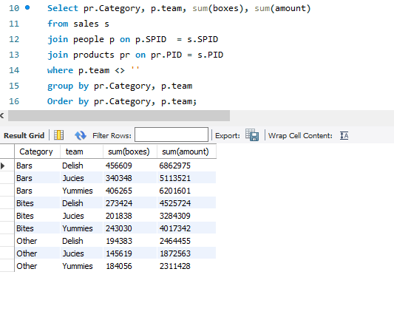
"Write a query to retrieve the total number of boxes (sum(boxes)) and total sales amount (sum(amount)) for each product category and salesperson team, by joining the Sales table (s) with the People table (p) and the Products table (pr). Use the SPID column to join Sales and People, and the PID column to join Sales and Products. Filter the results to include only teams where p.team is not empty. Group the data by product category and salesperson team, and order the results by product category and team.

Slide 26
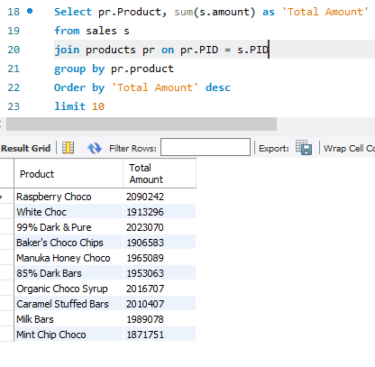
"Write a query to retrieve the top 10 products with the highest total sales amount (sum(amount)), by joining the Sales table (s) with the Products table (pr) using the PID column. Group the data by product name and order the results in descending order of total sales amount. Include the columns pr.Product and sum(s.amount) as 'Total Amount'.

Slide 27
Insights
Sales Trends
High-value sales (>10,000) predominantly occur in specific months or years, as shown by temporal filtering and ordering.
Products contributing significantly to revenue are identified, with a top 10 list highlighting their impact on overall sales.
Team and Region Performance
Teams like 'Juices' and 'Delish' show distinct performance metrics, with clear differences in their contribution to total sales volume.
Geographic analysis highlights areas like 'India' and 'New Zealand' as key markets for growth opportunities.
Customer and Product Segmentation
Products categorized by sales amounts ('Under 1K', 'Under 5K', etc.) show the distribution of customer spending patterns.
High-demand product categories and their alignment with team efforts reveal targeted areas for further investment.
Operational Efficiency
Analysis of box quantities (between 0 and 50) reveals patterns in order sizes that can guide inventory and shipping strategies.
Teams with low-performance metrics or regions with lesser sales could be further evaluated for improvement initiatives.

Slide 28
Conclusion
The sales dataset provides a comprehensive view of transaction-level data and enables a detailed breakdown of sales across various dimensions such as time, geography, and teams.
Teams like 'Delish' are underperforming in smaller sales but may have potential in higher-value segments.
Certain geographies and products dominate sales figures, indicating areas for concentrated marketing or product launches.

Slide 29
Recommendations
Strategic Sales Focus
Expand marketing and product launches in high-performing regions like India and New Zealand.
Revisit strategies for underperforming teams, providing tailored training or incentives.
Product Development
Focus on top-performing products while analyzing low-performing ones for potential redesign or discontinuation.
Inventory Optimization
Adjust inventory to align with product categories that frequently sell in small box quantities.
Performance Review
Conduct regular reviews of team performance, emphasizing data-driven feedback and goal setting.

Slide 30
SQL Query Contribution to Insights
Filters and Aggregates: Helped isolate high-value sales and average performance.
Joins: Provided a holistic view by combining sales data with team, product, and geographic information.
Categorization and Segmentation: Enabled grouping of sales data into actionable categories for strategic planning.

